Slide 1
LOAN AMOUNT PREDICTION
GROUP 5

Slide 2
INTRODUCTION
When someone borrows some money from someone or some organization, in financial term it is known as loan .Distribution of the loans is the core business part of almost every banks. The main portion the bank’s assets directly came from the profit earned from the loans distributed by the banks. The prime objective in banking environment is to invest their assets in safe hands where it is. Today many banks/financial companies approves loan after a regress process of verification and validation but still there is no surety whether the chosen applicant is the deserving right applicant out of all applicants. Through this system we can predict whether that particular applicant is safe or not and the whole process of validation of features is automated by machine learning technique.

Slide 3
OBJECTIVE
The main objective of this project is to predict whether assigning the loan to particular person will be safe or not. In this project we are predict the loan data by using some machine learning algorithms .

Slide 4
BACKGROUND
The above Loan status prediction is a clear classification problem as we need to classify whether the Loan Status is yes or no. So, this can be solved by any of the classification techniques like Logistic Regression .Decision Tree Algorithm . Random Forest Technique . This project is divided into four sections (i) Data Collection (ii) Comparison of machine learning models on collected data (iii) Training of system on most promising model (iv) Testing Data Set : The training data set is now supplied to machine learning model, on the basis of this data set the model is trained.

Slide 5
DATA PREPROCESSING
Data preprocessing is a process of preparing the raw data and making it suitable for a machine learning model. It is the first and crucial step while creating a machine learning model.
When creating a machine learning project, it is not always a case that we come across the clean and formatted data. And while doing any operation with data, it is mandatory to clean it and put in a formatted way. So for this, we use data preprocessing task.
Why do we need Data Preprocessing?
A real-world data generally contains noises, missing values, and maybe in an unusable format which cannot be directly used for machine learning models. Data preprocessing is required tasks for cleaning the data and making it suitable for a machine learning model which also increases the accuracy and efficiency of a machine learning model.

Slide 6
Data Preprocessing involves following steps:
Getting the dataset
Importing libraries
Importing datasets
Finding Missing Data
Encoding Categorical Data
Splitting dataset into training and test set
Feature scaling

Slide 7
Exploratory Data Analysis
Exploratory data analysis (EDA) is used by data scientists to analyze and investigate data sets and summarize their main characteristics, often employing data visualization methods. It helps determine how best to manipulate data sources to get the answers you need, making it easier for data scientists to discover patterns, spot anomalies, test a hypothesis, or check assumptions.
EDA is primarily used to see what data can reveal beyond the formal modeling or hypothesis testing task and provides a provides a better understanding of data set variables and the relationships between them. It can also help determine if the statistical techniques you are considering for data analysis are appropriate. Originally developed by American mathematician John Tukey in the 1970s, EDA techniques continue to be a widely used method in the data discovery process today.

Slide 8
Why is exploratory data analysis important in data science?
The main purpose of EDA is to help look at data before making any assumptions. It can help identify obvious errors, as well as better understand patterns within the data, detect outliers or anomalous events, find interesting relations among the variables.
Data scientists can use exploratory analysis to ensure the results they produce are valid and applicable to any desired business outcomes and goals. EDA also helps stakeholders by confirming they are asking the right questions. EDA can help answer questions about standard deviations, categorical variables, and confidence intervals. Once EDA is complete and insights are drawn, its features can then be used for more sophisticated data analysis or modeling, including machine learning.

Slide 9
Data Visualization
Data visualization is defined as a graphical representation that contains the information and the data.
By using visual elements like charts, graphs, and maps, data visualization techniques provide an accessible way to see and understand trends, outliers, and patterns in data.
In modern days we have a lot of data in our hands i.e, in the world of Big Data, data visualization tools, and technologies are crucial to analyze massive amounts of information and make data-driven decisions.

Slide 10
Analysis Techniques for Data Visualization
Box and Whisker Plot
This plot can be used to obtain more statistical details about the data.
The straight lines at the maximum and minimum are also called whiskers.
Points that lie outside the whiskers will be considered as an outlier.
The box plot also gives us a description of the 25th, 50th,75th quartiles.
With the help of a box plot, we can also determine the Interquartile range(IQR) where maximum details of the data will be present. Therefore, it can also give us a clear idea about the outliers in the dataset.

Slide 11
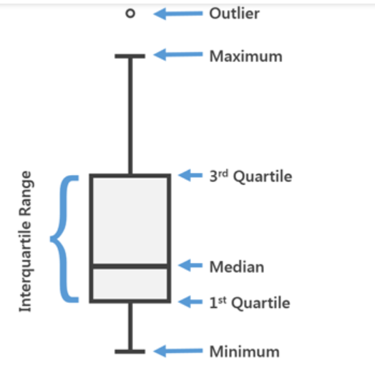
General Diagram for a Box-plot

Slide 12
Violin Plot
The violin plots can be considered as a combination of Box plot at the middle and distribution plots(Kernel Density Estimation) on both sides of the data.
This can give us the description of the distribution of the dataset like whether the distribution is multimodal, Skewness, etc.
It also gives us useful information like a 95% confidence interval.

Slide 13
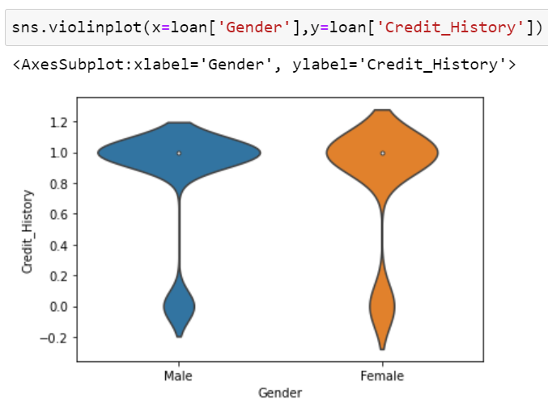
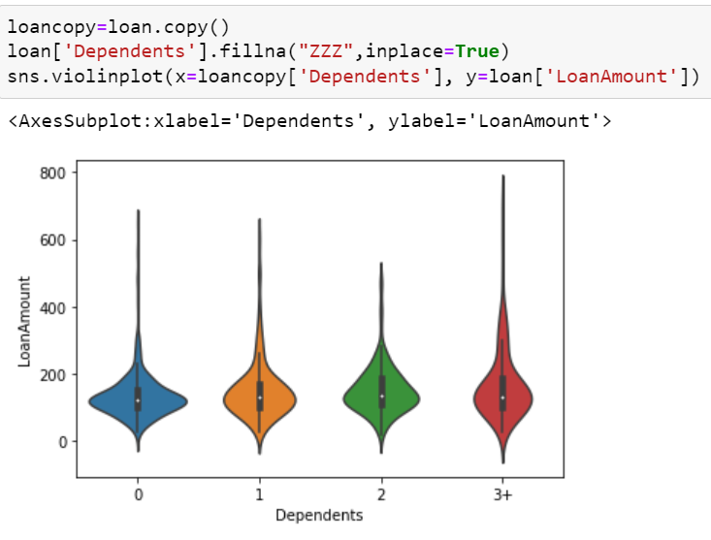
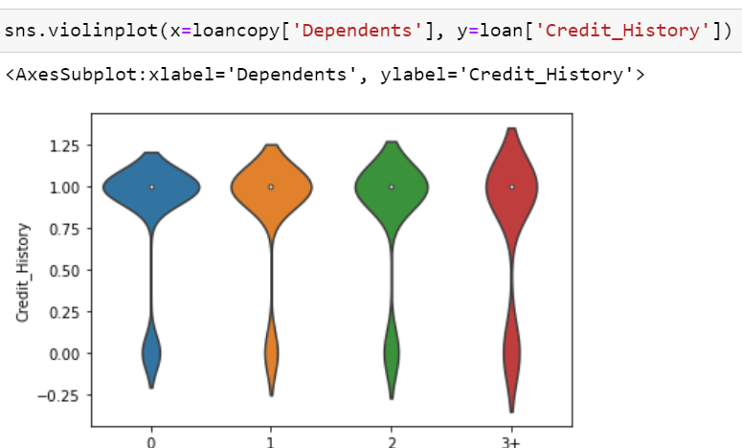
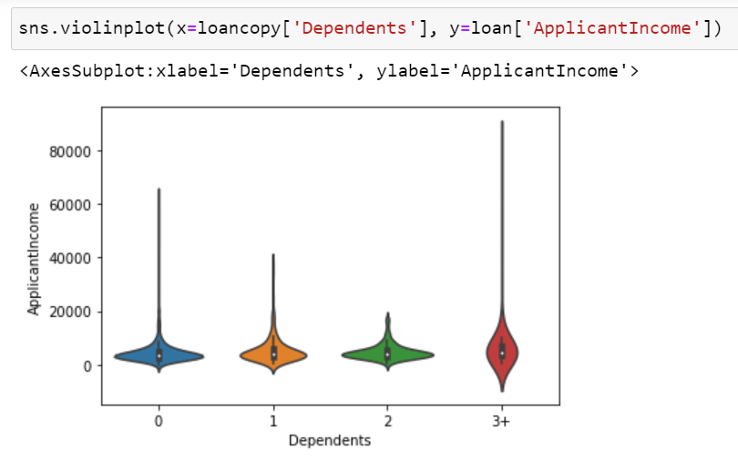

Slide 14
Heat Map
A heat map is a two-dimensional representation of information with the help of colors. Heat maps can help the user visualize simple or complex information. Heat maps are used in many areas such as defense, marketing and understanding consumer behavior.

Slide 15
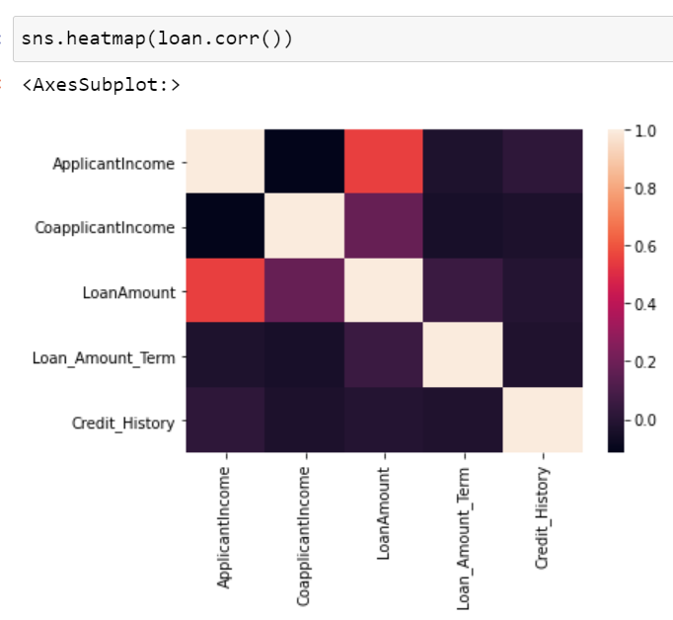

Slide 16
Countplot
The countplot is used to represent the occurrence(counts) of the observation present in the categorical variable.
It uses the concept of a bar chart for the visual depiction.

Slide 17
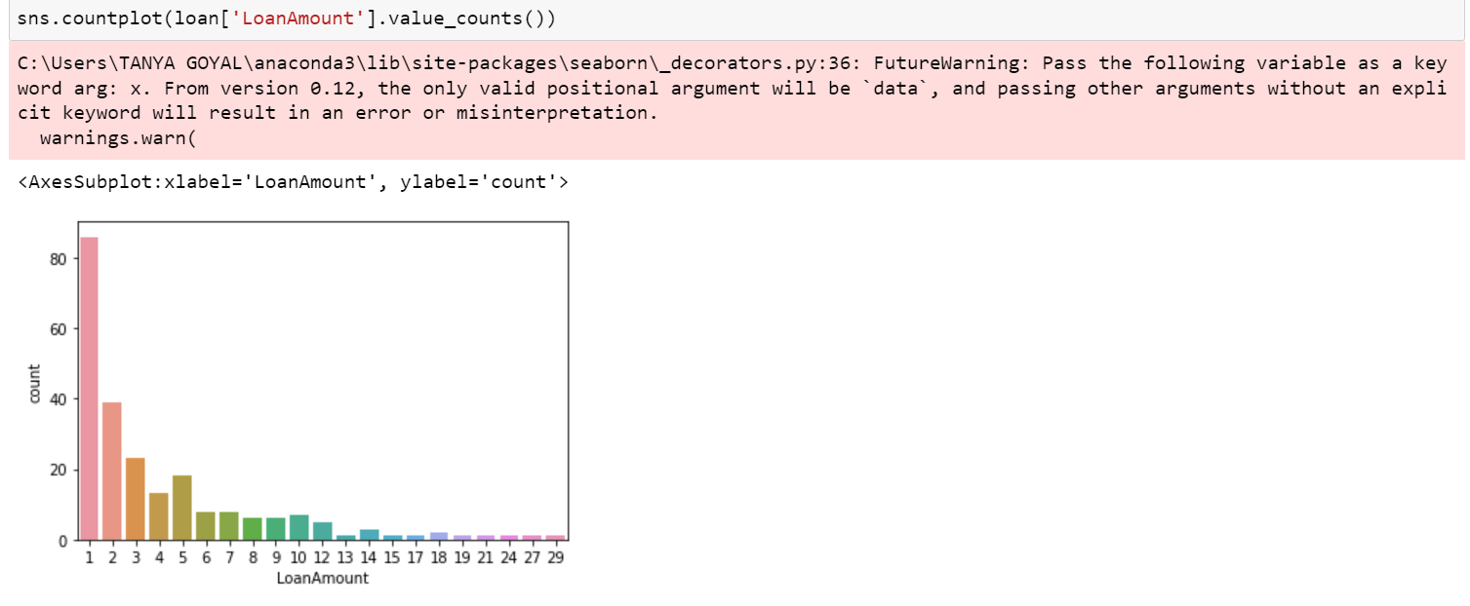

Slide 18
Displot
Displot these are the plots which let us show a histogram with a line on it. In all kind of variations it can be shown, and displot combines the matplotlib hist function with seaborn kdeplot and rugplot functions.

Slide 19
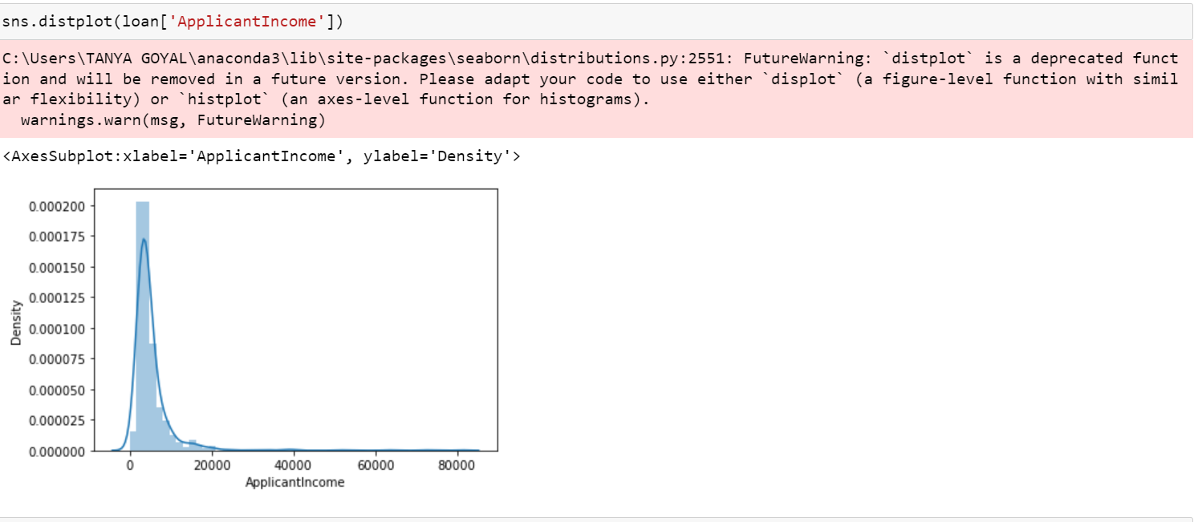

Slide 20
Logistic Regression
Logistic regression is one of the most popular Machine Learning algorithms, which comes under the Supervised Learning technique. It is used for predicting the categorical dependent variable using a given set of independent variables.
Logistic regression predicts the output of a categorical dependent variable. Therefore the outcome must be a categorical or discrete value. It can be either Yes or No, 0 or 1, true or False, etc. but instead of giving the exact value as 0 and 1, it gives the probabilistic values which lie between 0 and 1.
Logistic Regression is much similar to the Linear Regression except that how they are used. Linear Regression is used for solving Regression problems, whereas Logistic regression is used for solving the classification problems.

Slide 21
FUTURE SCOPE
In future, this model can be used to compare various machine learning algorithm generated prediction models and the model which will give higher accuracy will be chosen as the prediction model. This paper work can be extended to higher level in future. Predictive model for loans that uses machine learning algorithms, where the results from each graph of the paper can be taken as individual criteria for the machine learning algorithm

Slide 22
THANK YOU

